Slide 1
DTI5125
Group Project:
Question Answering on SQuAD dataset
Group: 13

Slide 2
Table of contents
Introduction
Methodology
A. Question Answering
B. Clustering
C. Classification

Slide 3
Introduction
Question answering models are one of the most used applications in NLP. In this project Stanford question answering dataset was used, also, a question answering model was built with a transformer-based architecture on a generic task and then finetuned on the task at hand. The transformer’s implementation that will was used is provided by HuggingFace library. Some data cleaning techniques were used in preprocessing. Nevertheless, Clustering and classification techniques were applied with various number of models.

Slide 4
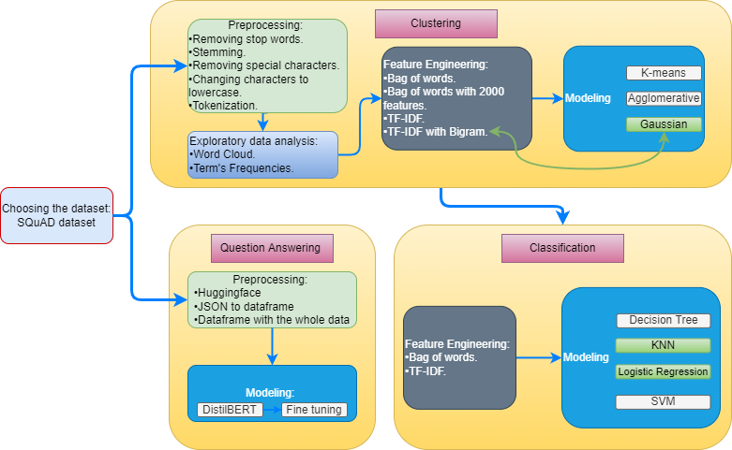
Methodology

Slide 5
A. Question Answering
Preprocessing
Modeling
Evaluation

Slide 6
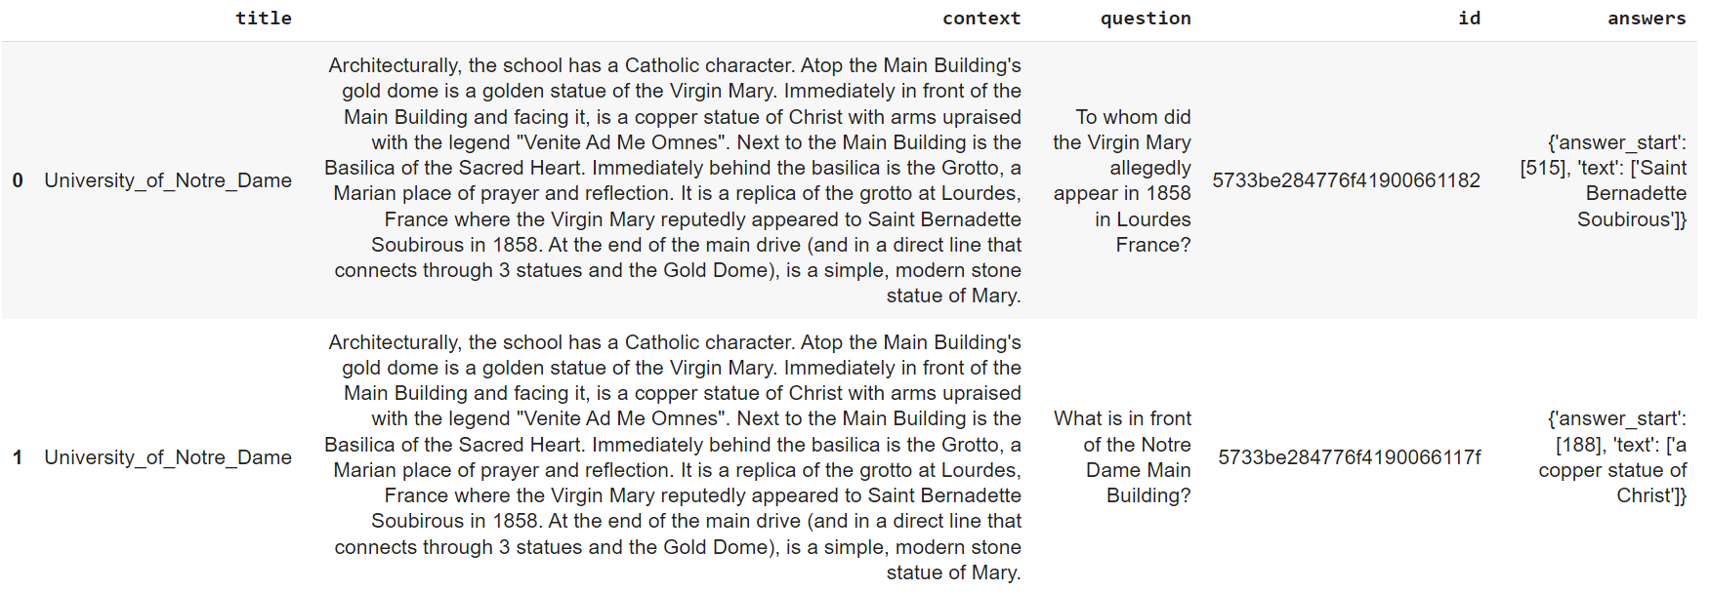
Question Answering – Preprocessing
(Dataset Split)
Loading dataset using Huggingface’s loading function which returns a dict-link object called “DatasetDict” which incapsulate the real dataset.
A JSON file is converted to dataframe to facilitate dealing with it.
The function from previous step is then used to create “Dataframe” that contains the whole dataset.
Output data:

Slide 7
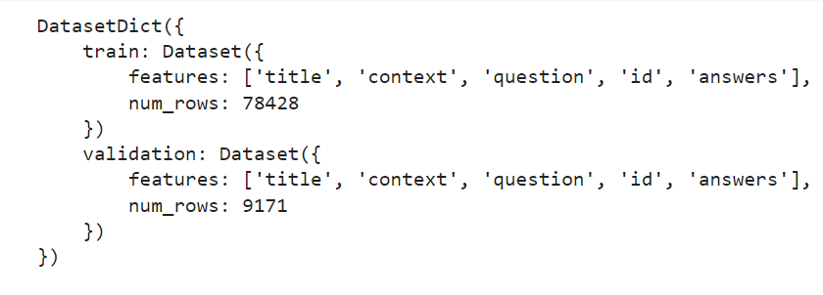
Question Answering – Preprocessing
(Dataset Split)
Result of data split:

Slide 8
Question Answering – Modeling
(Transformers)
Two things need to be specified in “Trainer” class:
one is “TrainingArguments” which specifies saving folder, batch's size, learning rate, etc.
Secondly, “Data_colletor” which is used to batch together sequences having different length.

Slide 9
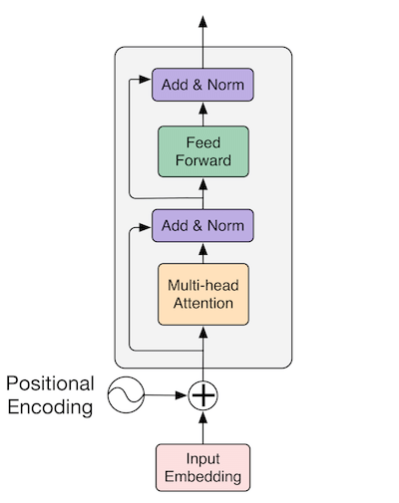
Question Answering – Modeling
(Transformers)
DistilBERT:
The preprocessing is handled by HuggingFace's Tokenizer class.
In handling long sequences: truncation cannot be used in this case so sliding the input sentence over the model with a certain stride was used instead allowing a certain degree of overlapping.

Slide 10
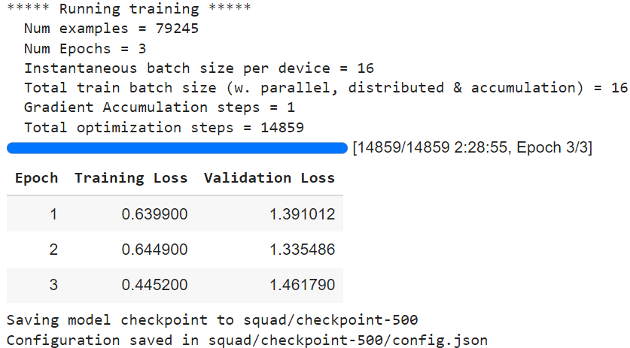
Question Answering – Modeling
(Fine tuning)
The method of the class is used to trigger the finetuning process.

Slide 11
Question Answering – Evaluation
(Error analysis of DistilBERT)
In order to analyze what kind of errors the model made, the mistaken predictions should first be retrieved. With "mistaken predictions" are intended those predictions that do not exactly match with the ground truth.
Number of mistaken predictions are : 2827/9171
Exact match : 69.1745720204994, F1-Score: 80.48996193217269

Slide 12
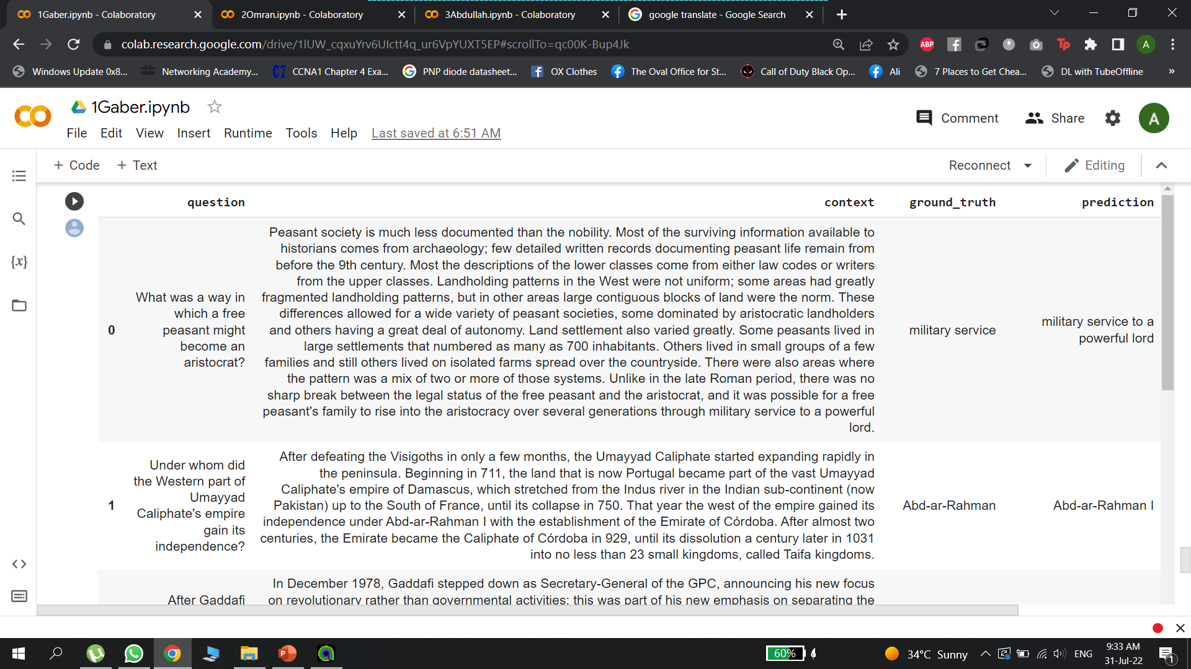
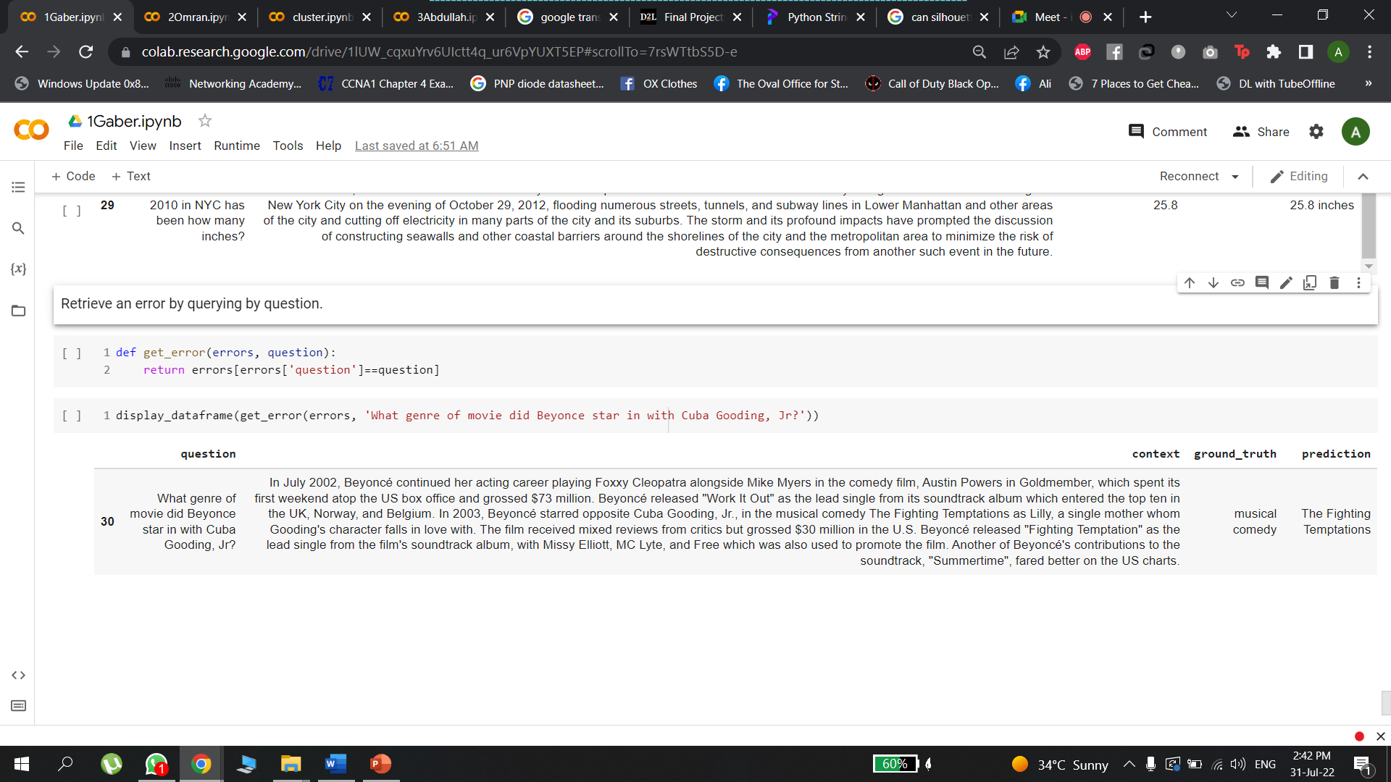
Question Answering – Evaluation
(Error analysis of DistilBERT)
Part of the random questions used:
Mismatch between ground truth and prediction:

Slide 13
B. Clustering
Preprocessing
Modeling
Evaluation
Exploratory Data Analysis

Slide 14
Clustering – Preprocessing
(Text Cleaning)
Applied techniques:
Removing stop words.
Stemming.
Removing special characters.
Changing characters to lowercase.
Tokenization.

Slide 15
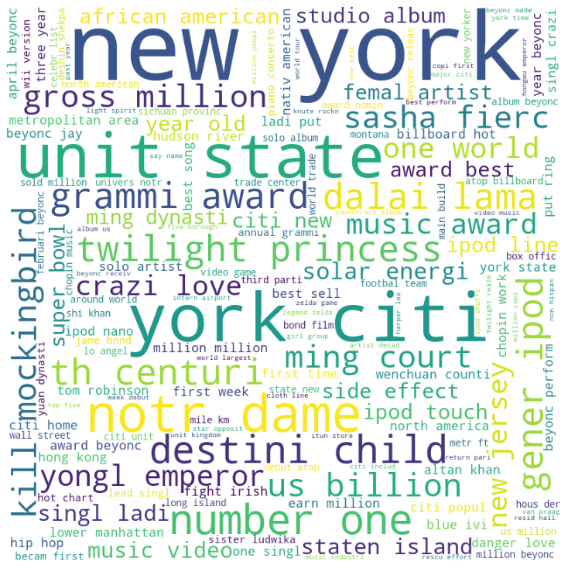
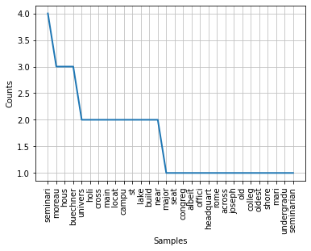
Clustering - Exploratory Data Analysis
Word Cloud:
Terms’ Frequencies:

Slide 16
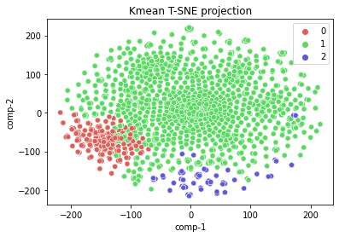
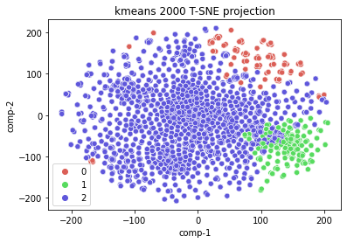
Clustering - Modeling (K-Means)
BOW:
BOW with 2000 features:
Silhouette Score: 0.10530761233249189
Silhouette Score: 0.12911411050392638

Slide 17
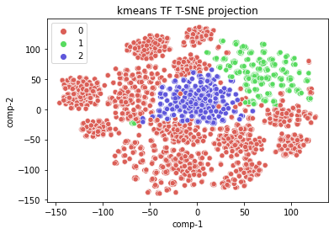
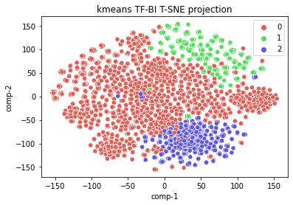
Clustering - Modeling (K-Means)
TF-IDF:
TF-IDF Bigram:
Silhouette Score: 0.015994630853594243
Silhouette Score: 0.006352911787470551

Slide 18
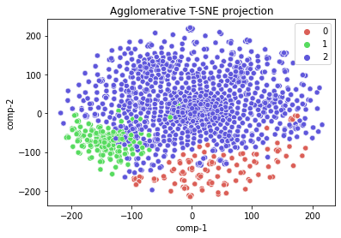
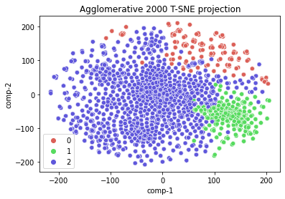
Clustering - Modeling (Agglomerative)
BOW:
BOW with 2000 features:
Silhouette Score: 0.08737506799310384
Silhouette Score: 0.07717509998982704

Slide 19
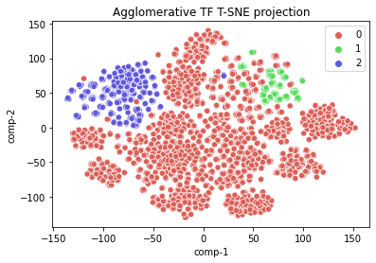
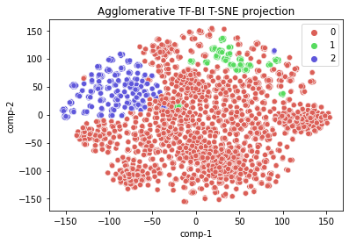
Clustering - Modeling (Agglomerative)
TF-IDF:
TF-IDF Bigram:
Silhouette Score: 0.006400279131565316
Silhouette Score: 0.010759753564862572

Slide 20
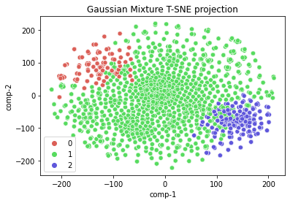
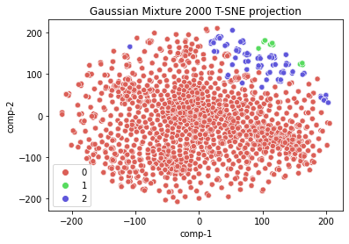
Clustering - Modeling (Gaussian)
BOW:
BOW with 2000 features:
Silhouette Score: -0.0025406249613993672
Silhouette Score: 0.16078049439336548

Slide 21
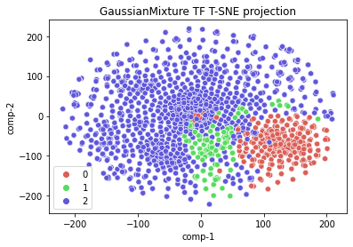
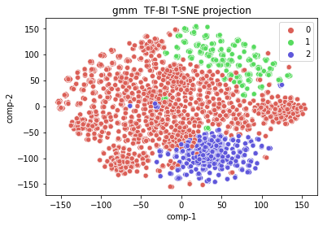
Clustering - Modeling (Gaussian)
TF-IDF:
TF-IDF Bigram:
Silhouette Score: 0.12911411050392638
Silhouette Score: 0.013475419112979916

Slide 22
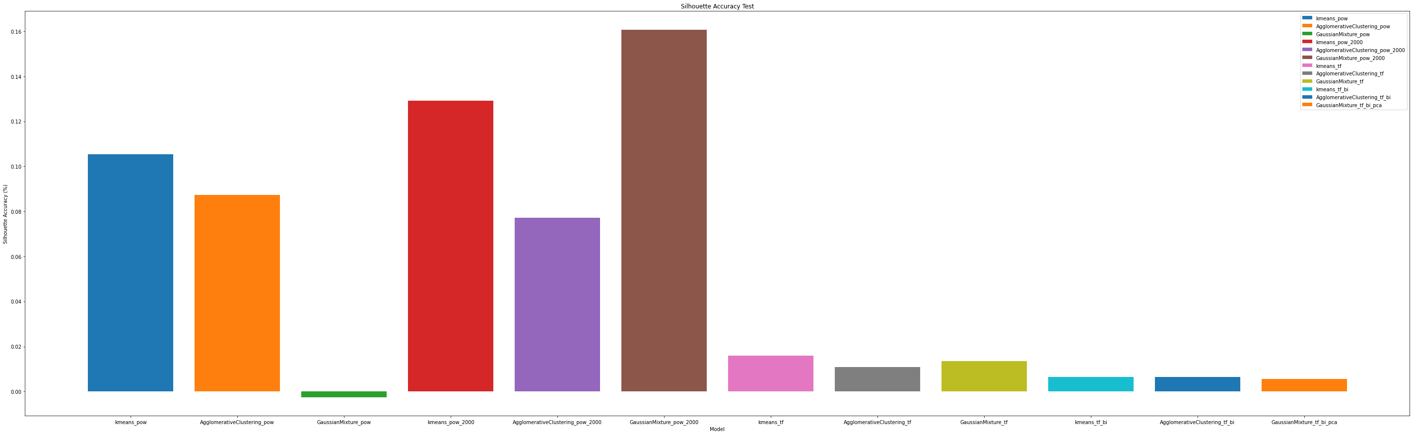
Clustering - Evaluation
The champion model is: Gaussian Mixture with BOW using 2000 features

Slide 23
C. Classification
Preprocessing
Modeling
Evaluation
Conclusion

Slide 24
Classification - Preprocessing
The preprocessing in classification is completely dependent on that of clustering so no additional processes or approaches were done. There are “context” and ”clean_context” columns, obtained clean_context column after we cleaned context column in clustering stage.

Slide 25
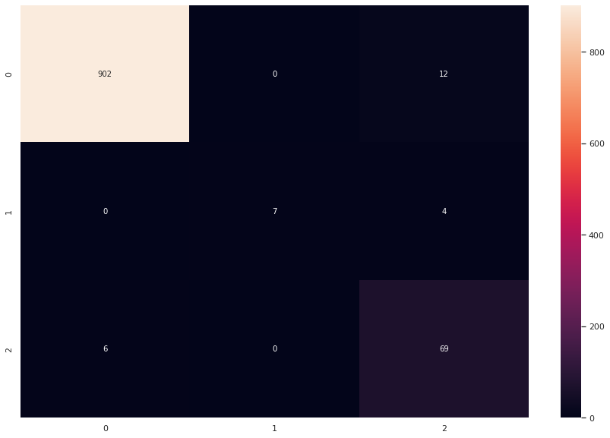
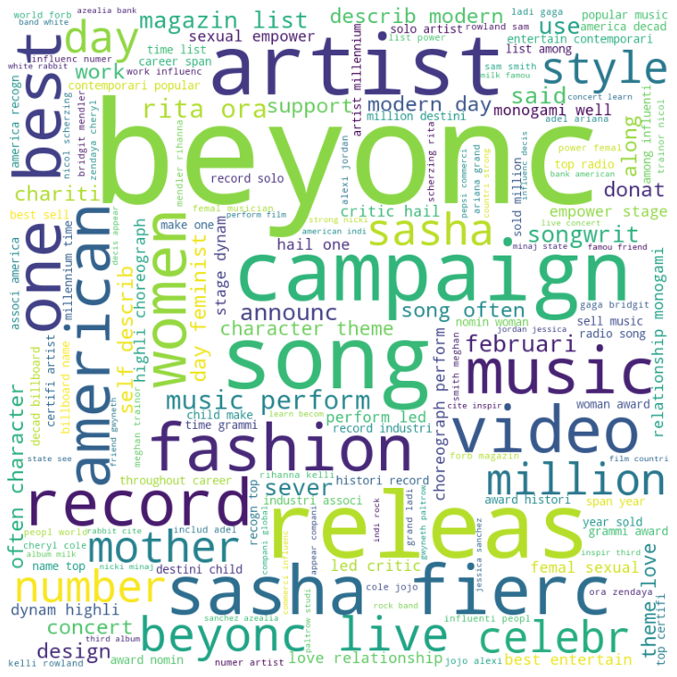
Classification – Modeling (Decision Tree)
BOW:
Confusion Matrix:
Error Analysis:
Kappa Score: 0.8655552567894595

Slide 26
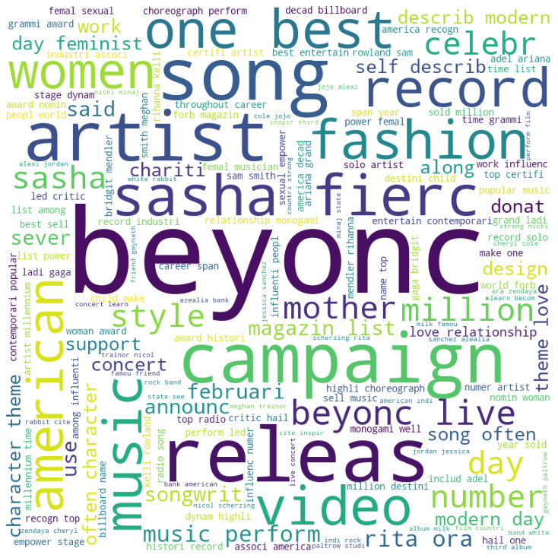
Classification – Modeling (Decision Tree)
TF-IDF:
Confusion Matrix:
Error Analysis:
Kappa Score: 0.8655552567894595

Slide 27
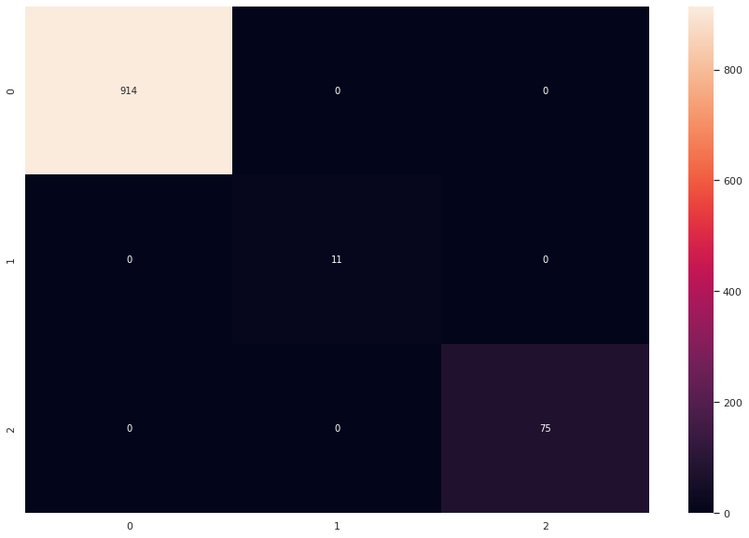
Classification – Modeling (KNN)
BOW:
Confusion Matrix:
Error Analysis:
We can not plot word cloud for because there’s no error, Kappa score = 1.0
Kappa Score: 1.0

Slide 28
Classification – Modeling (KNN)
TF-IDF:
Confusion Matrix:
Error Analysis:
We can not plot word cloud for because there’s no error, Kappa score = 1.0
Kappa Score: 1.0

Slide 29
Classification – Modeling (Logistic Regression)
BOW:
Confusion Matrix:
Error Analysis:
We can not plot word cloud for because there’s no error, Kappa score = 1.0
Kappa Score: 1.0

Slide 30
Classification – Modeling (Logistic Regression)
TF-IDF:
Confusion Matrix:
Error Analysis:
We can not plot word cloud for because there’s no error, Kappa score = 1.0
Kappa Score: 1.0

Slide 31
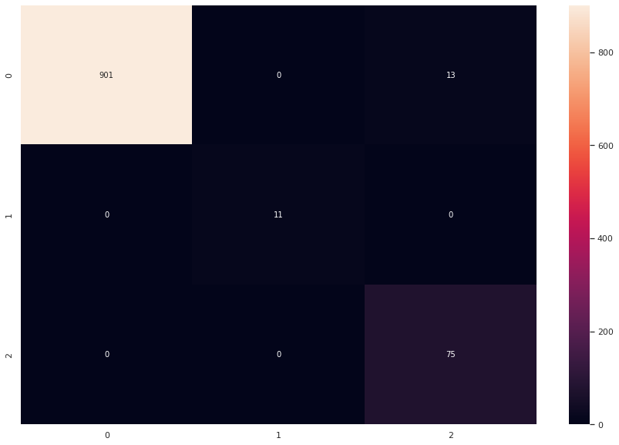
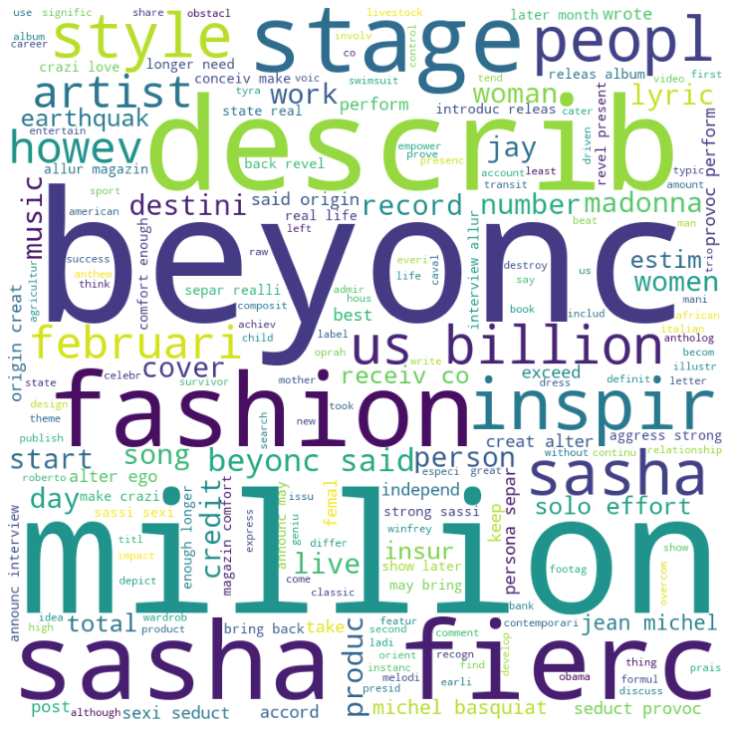
Classification – Modeling (SVM)
BOW:
Confusion Matrix:
Error Analysis:
Kappa Score: 0.9234235560922451

Slide 32

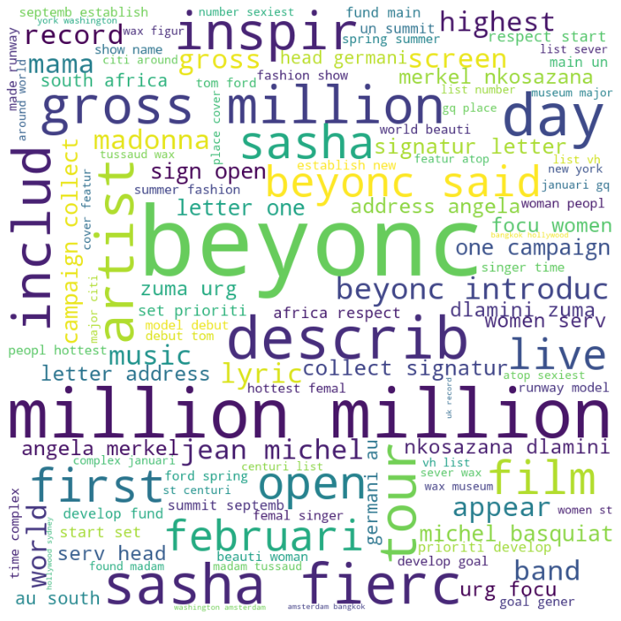
Classification – Modeling (SVM)
TF-IDF:
Confusion Matrix:
Error Analysis:
Kappa Score: 0.8998615733513975

Slide 33
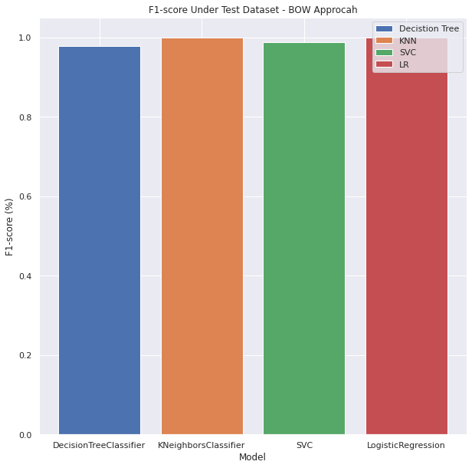
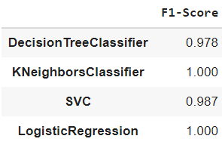
Classification – Evaluation
BOW:

Slide 34
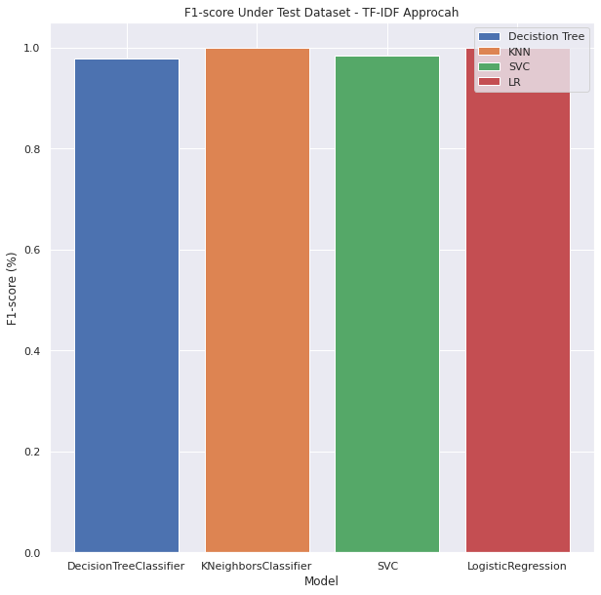
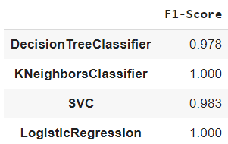
Classification – Evaluation
TF-IDF:

Slide 35
Classification - Conclusion
As we see in the above graphs of performance comparison, Both Logistic Regression and KNN models are the best models based on F1-score metrics using BOW or TF-IDF feature extraction approaches.
When different feature engineering methods were applied on the models, there was no difference in the outcome in decision tree, K-Nearest neighbors and logistic regression.

Slide 36
Thank You

